Slide 1
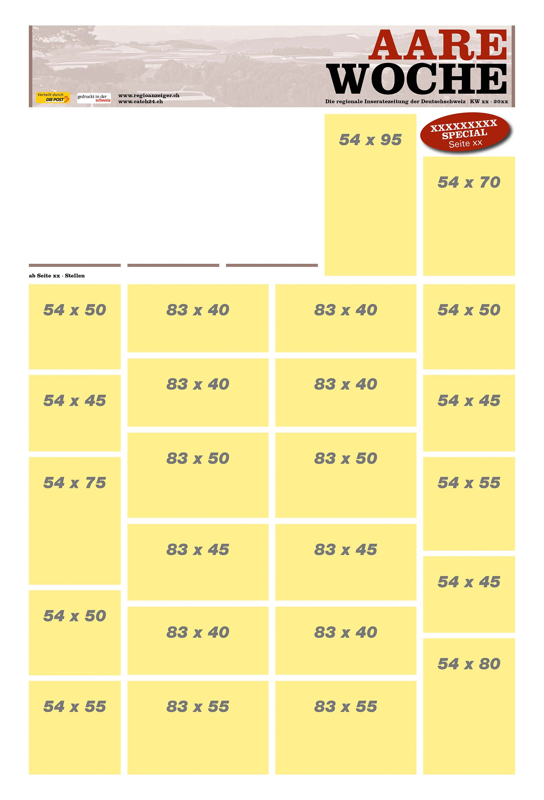
217781
54x50
217643
54x60
217807
54x100
TS/Regio
217941
54x30
217905
141x60

Slide 2
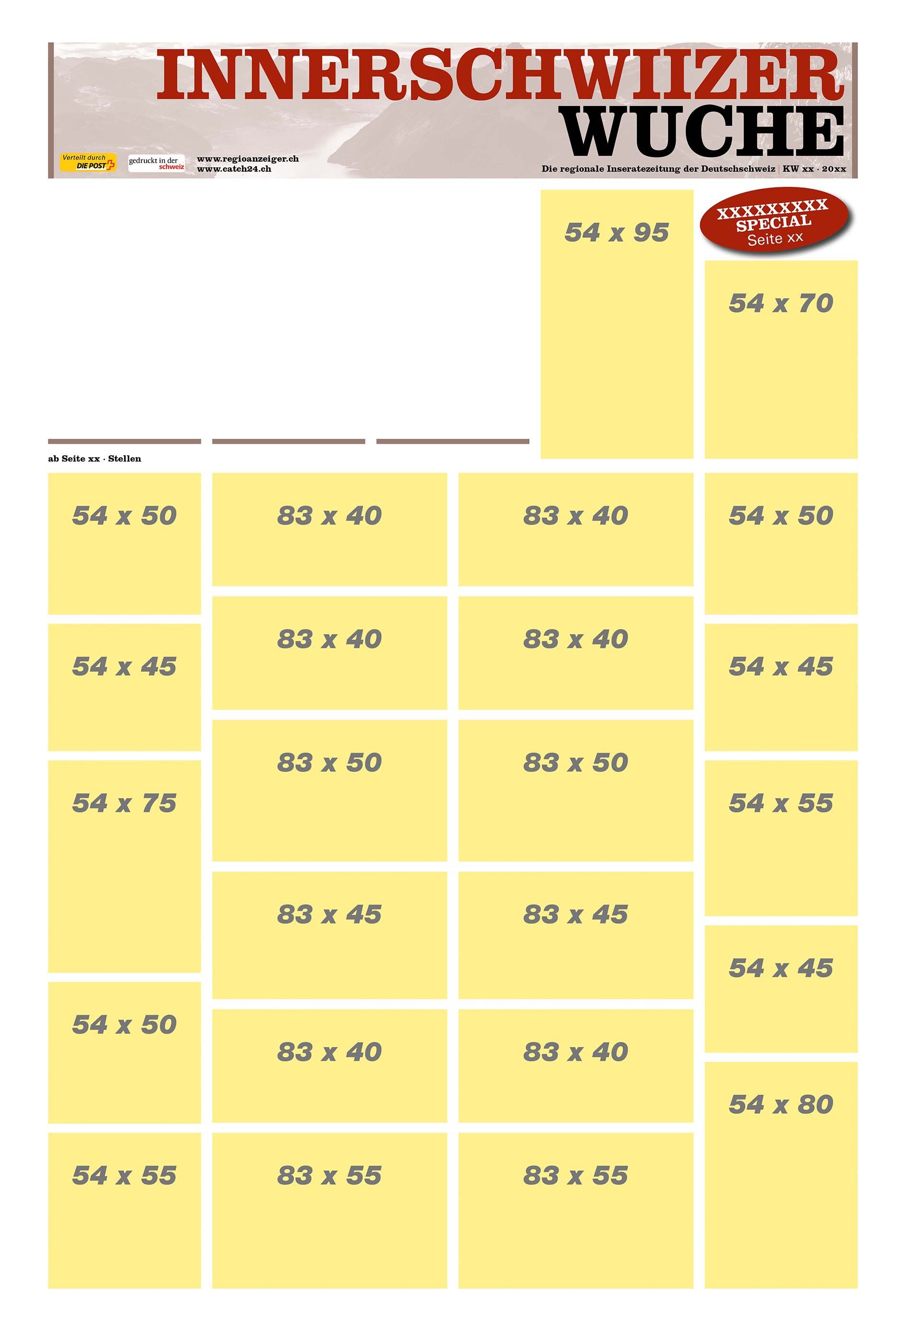
217781
54x50
217643
54x60
217807
54x100
TS/Regio
217941
54x30
217905
141x60

Slide 3
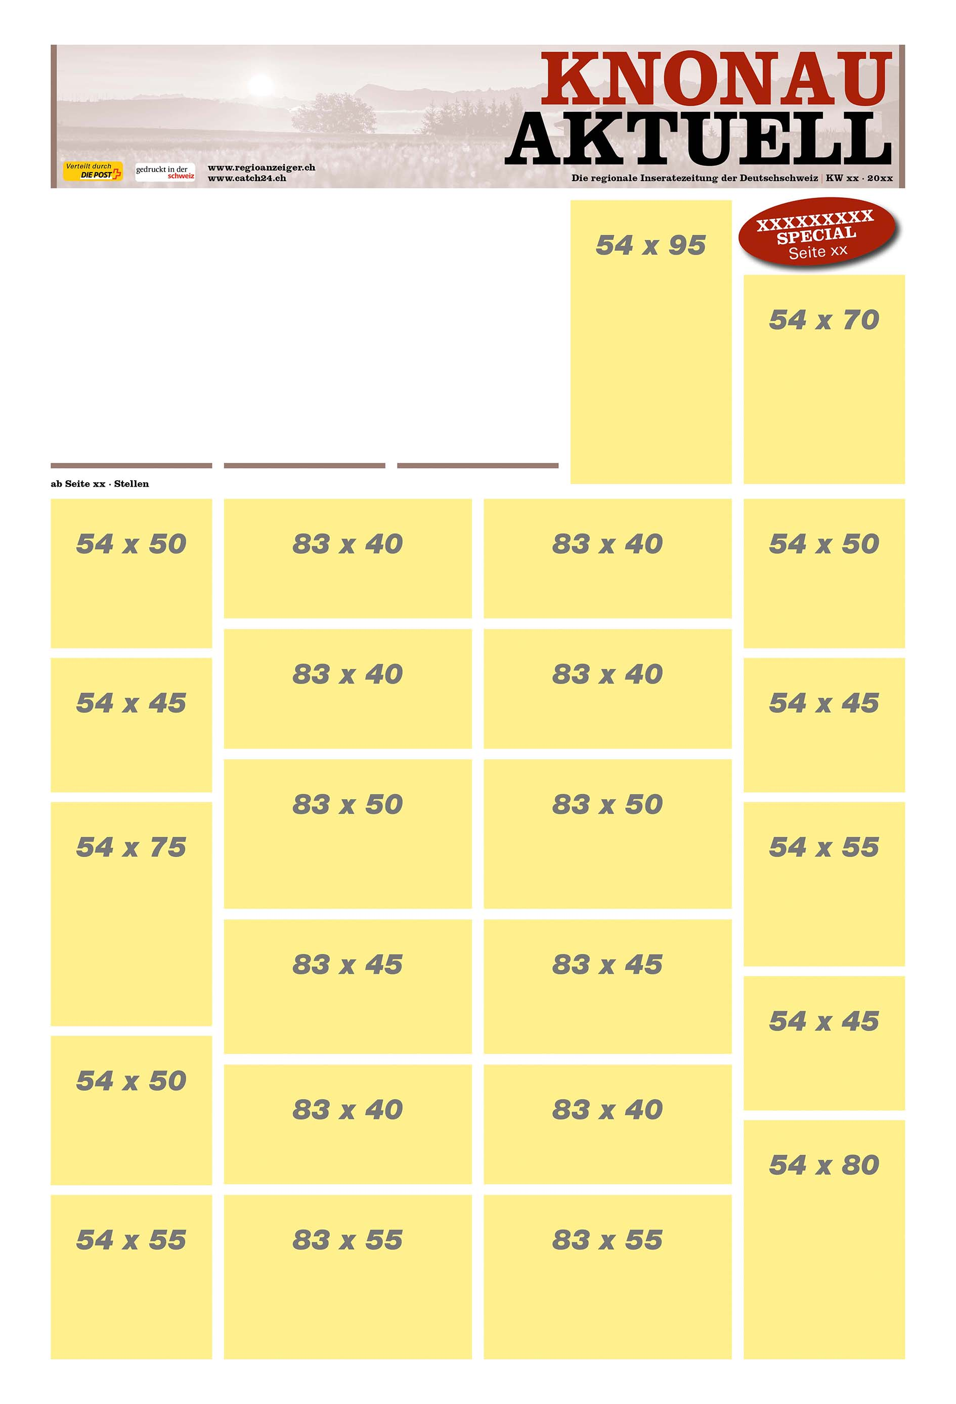
217781
54x50
217643
54x60
217807
54x100
TS/Regio
217941
54x30
217905
141x60

Slide 4
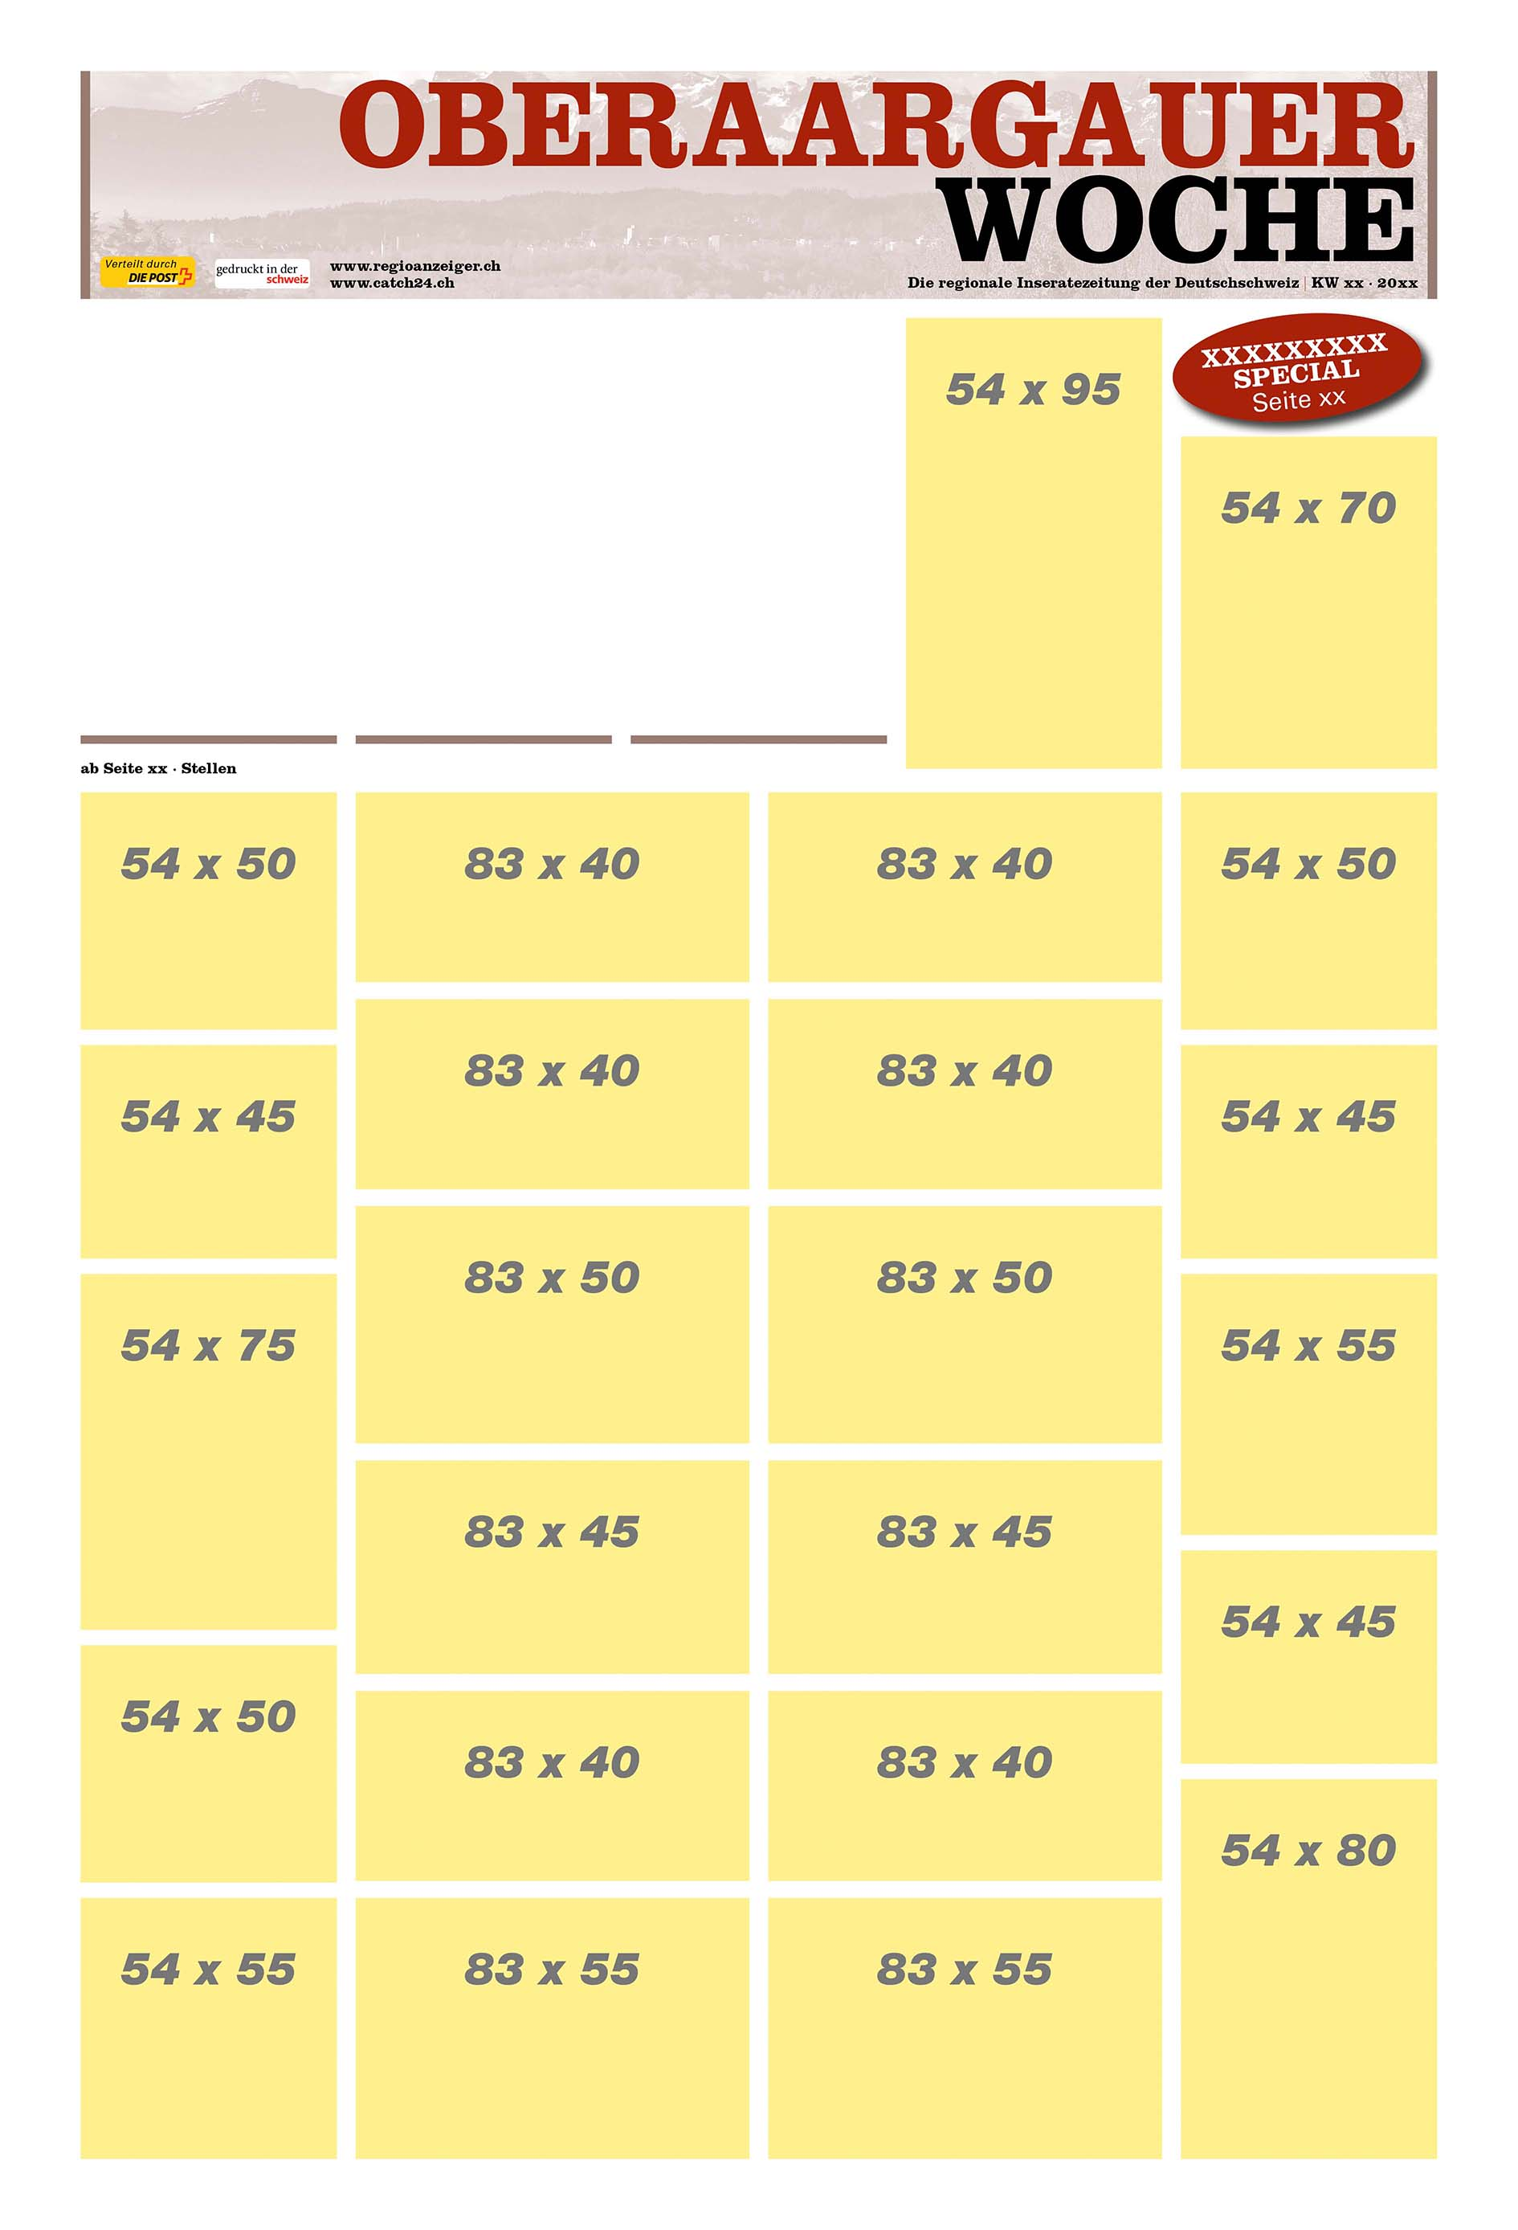
217781
54x50
217643
54x60
217807
54x100
TS/Regio
217941
54x30
217905
141x60

Slide 5
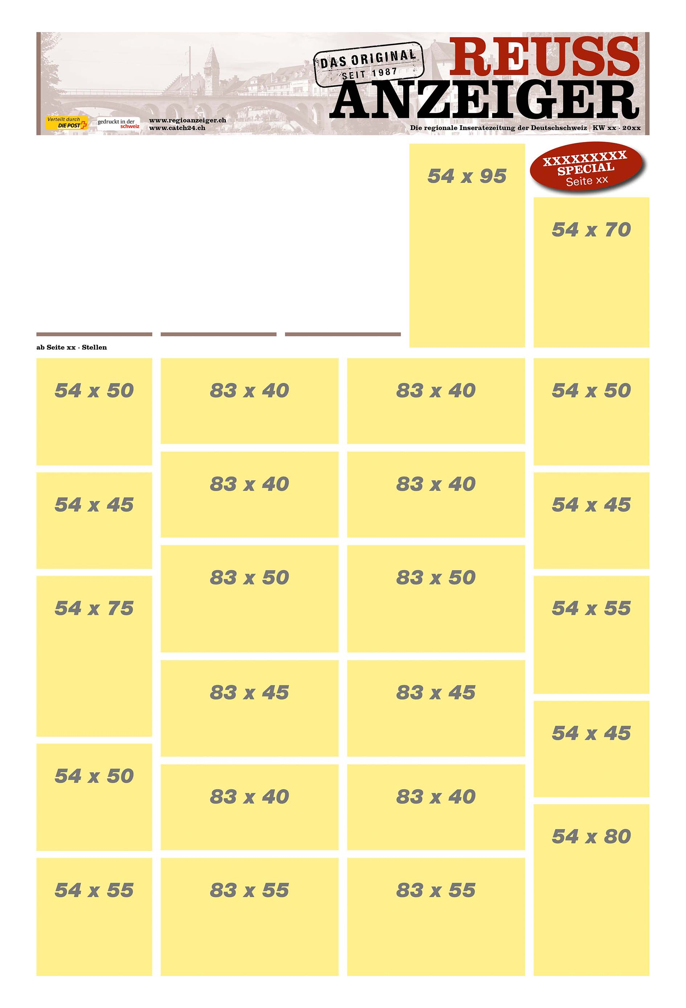
217781
54x50
217643
54x60
217807
54x100
TS/Regio
217619
83x65
217941
54x30
217905
141x60

Slide 6
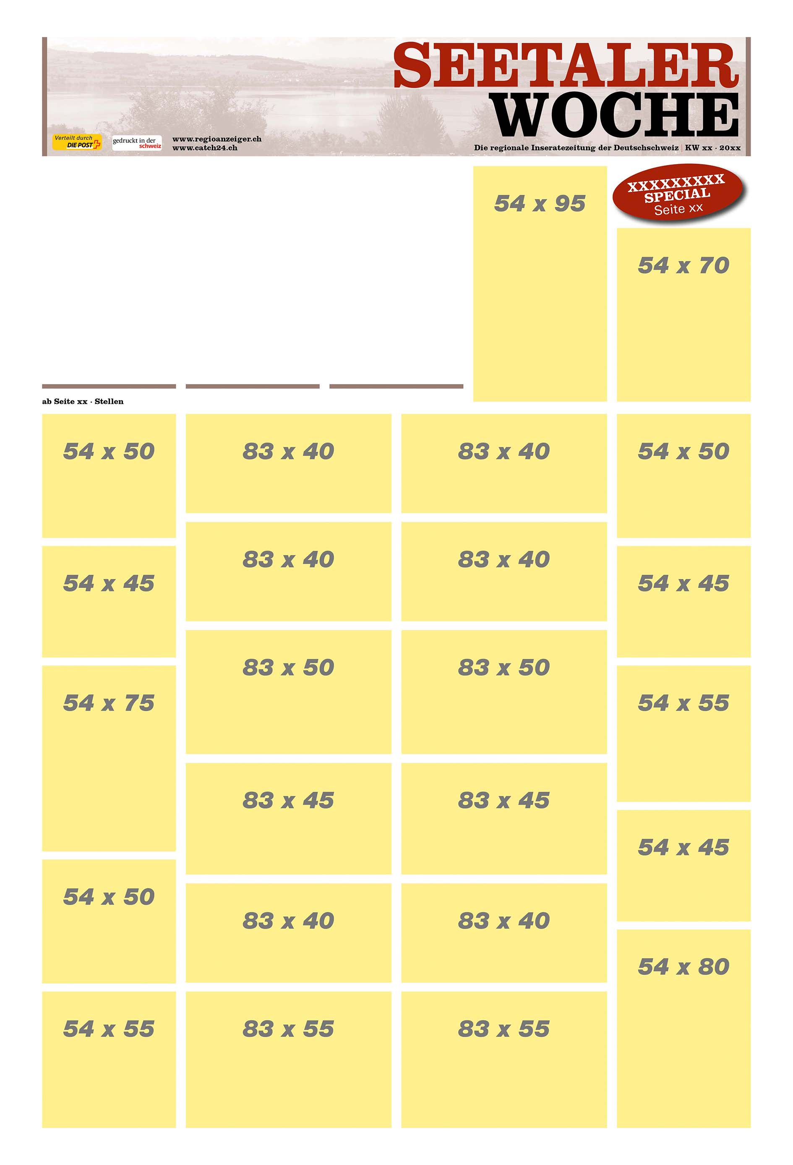
217781
54x50
217643
54x60
217807
54x100
TS/Regio
217619
83x65
217941
54x30
217905
141x60

Slide 7
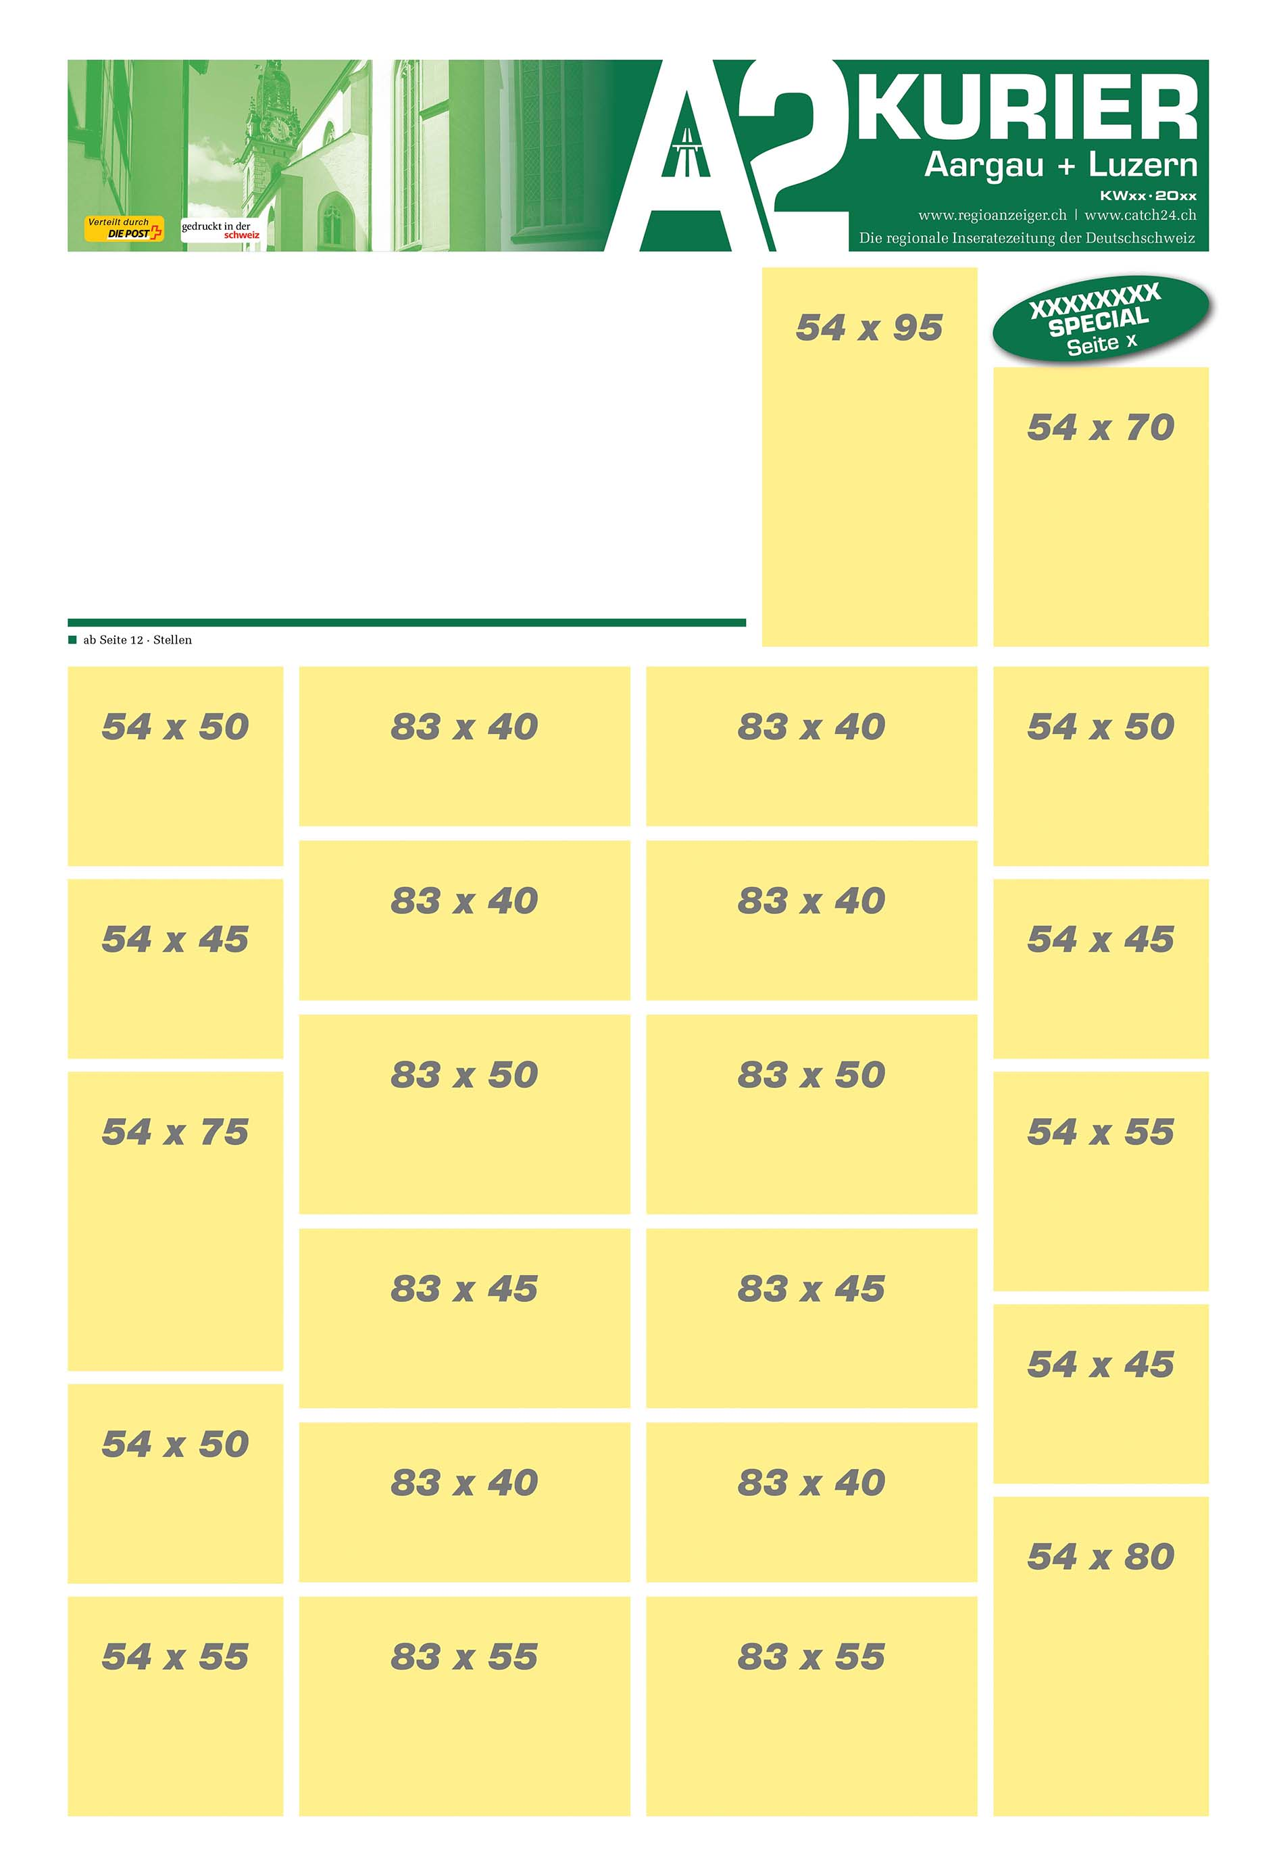
217781
54x50
217643
54x60
217807
54x100
TS/Regio
217941
54x30
217905
141x60

Slide 8
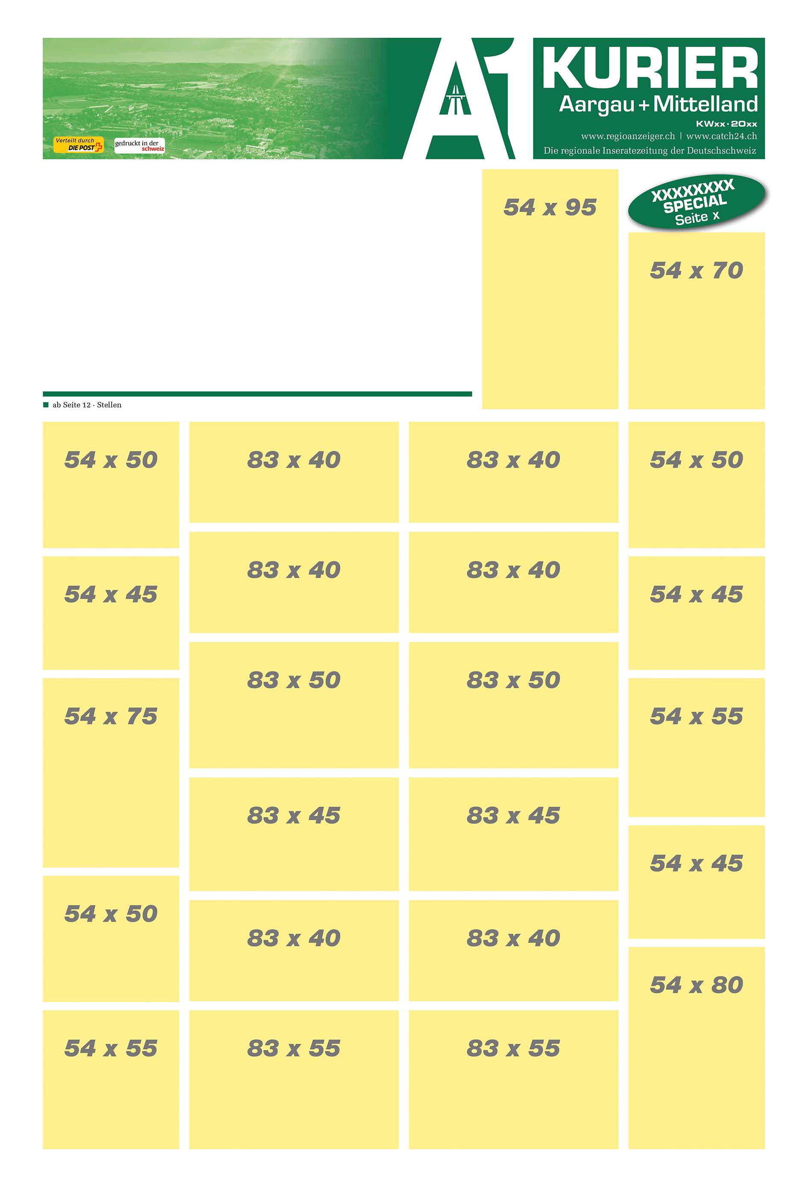
217781
54x50
217643
54x60
217807
54x100
TS/Regio
217941
54x30
217905
141x60

Slide 9
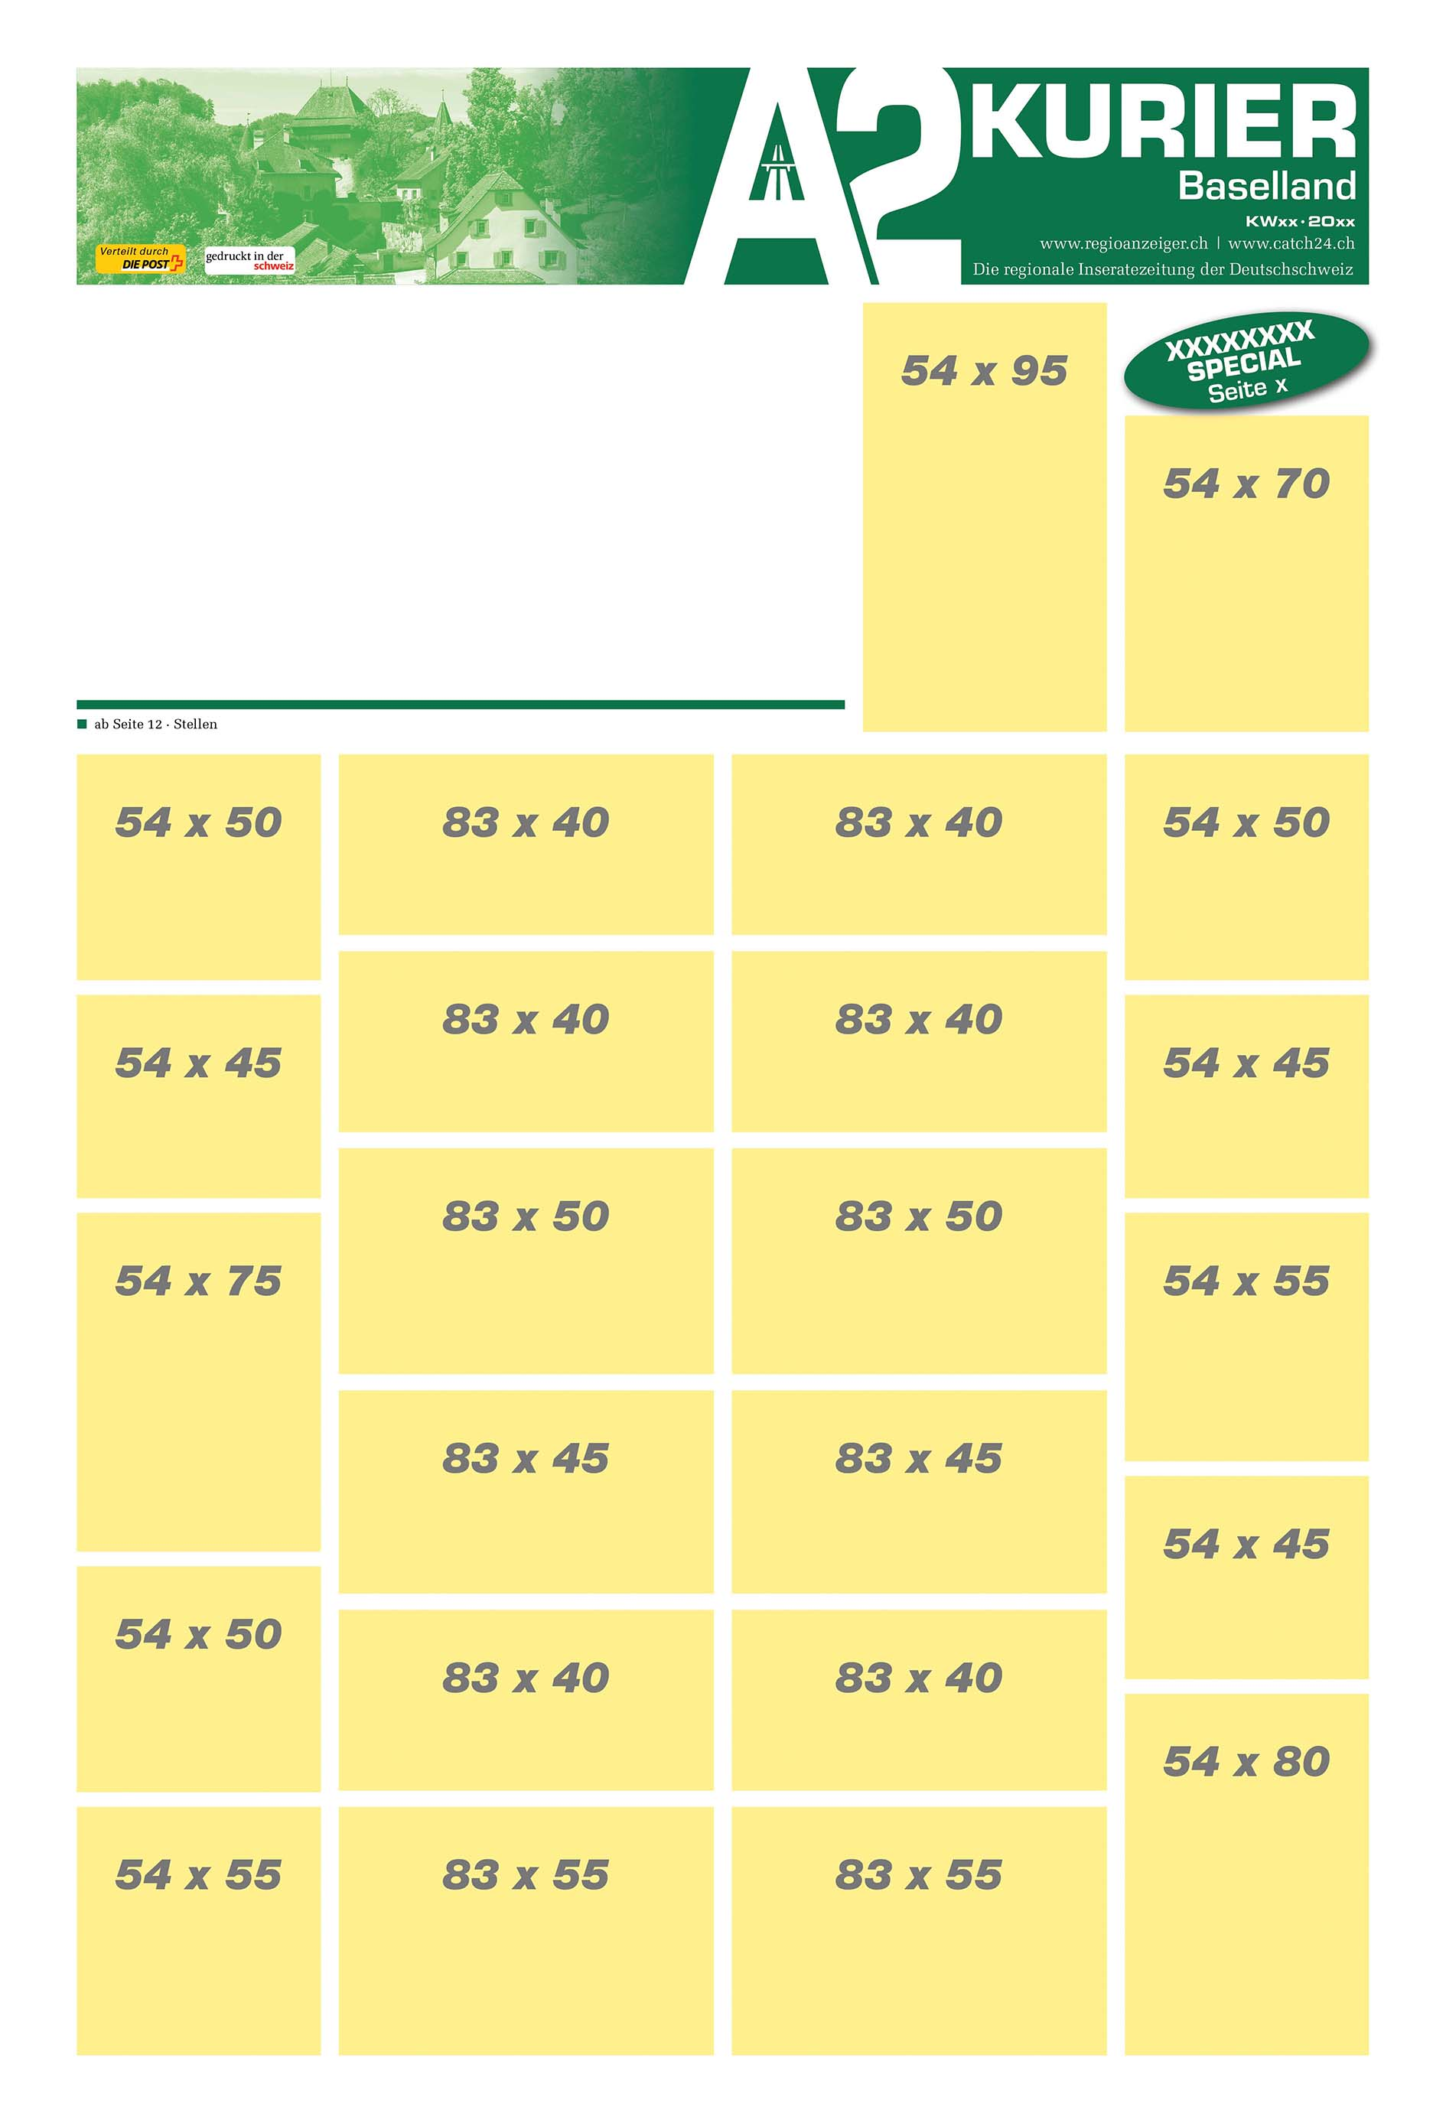
217781
54x50
217643
54x60
217807
54x100
TS/Regio
217941
54x30
217905
141x60

Slide 10
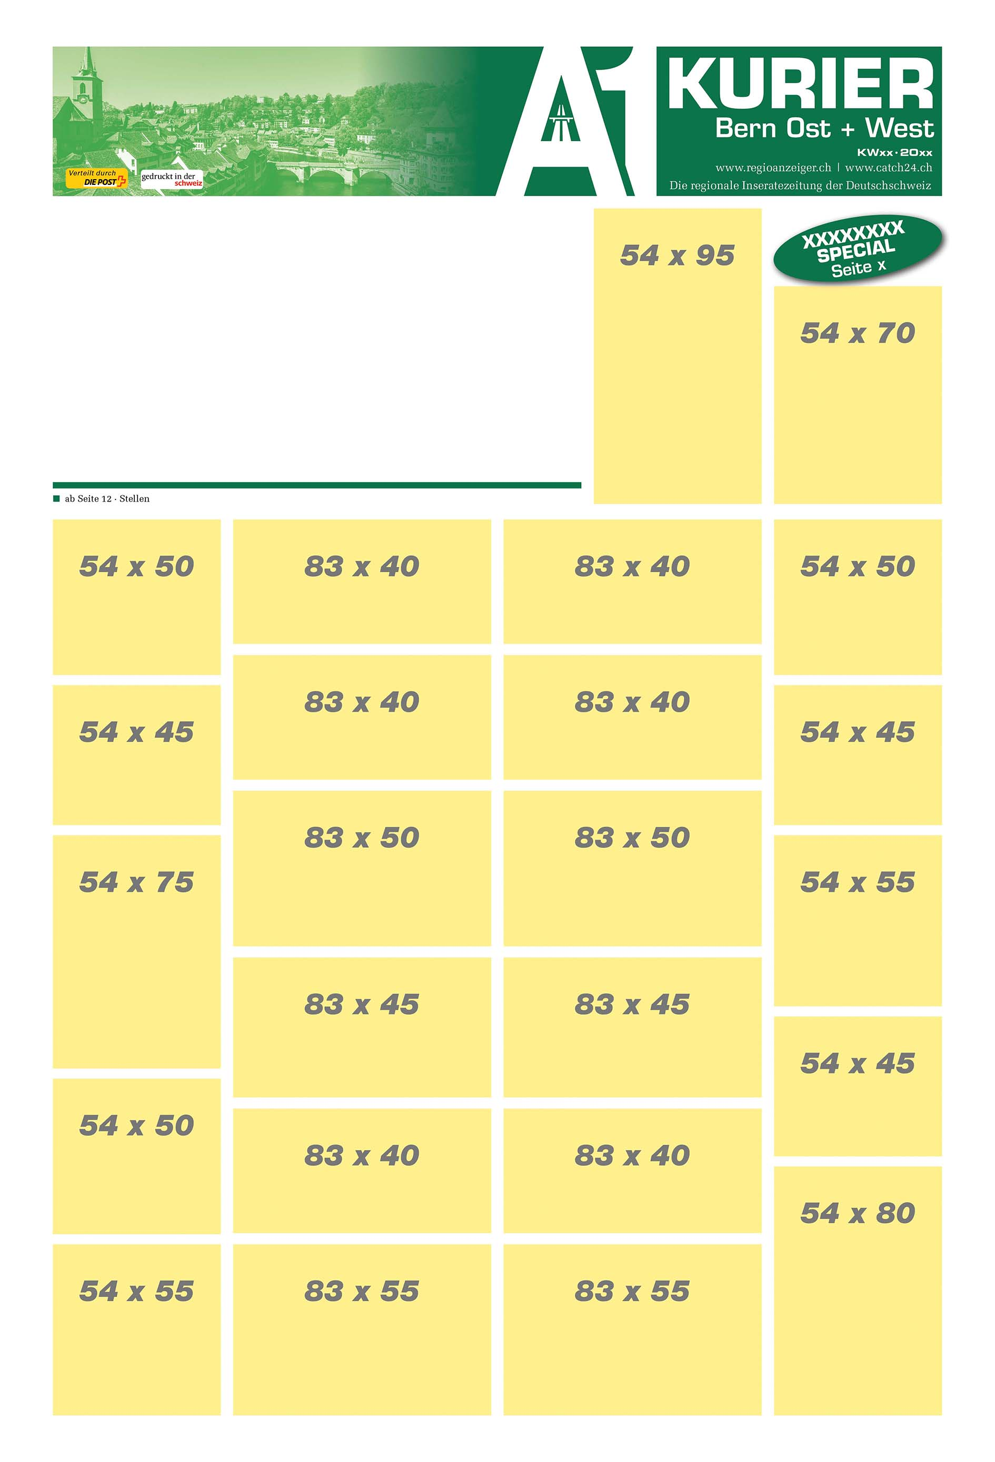
217781
54x50
217643
54x60
217807
54x100
TS/Regio
217941
54x30
217905
141x60

Slide 11
217781
54x50
217643
54x60
217807
54x100
TS/Regio
217941
54x30
217905
141x60

Slide 12
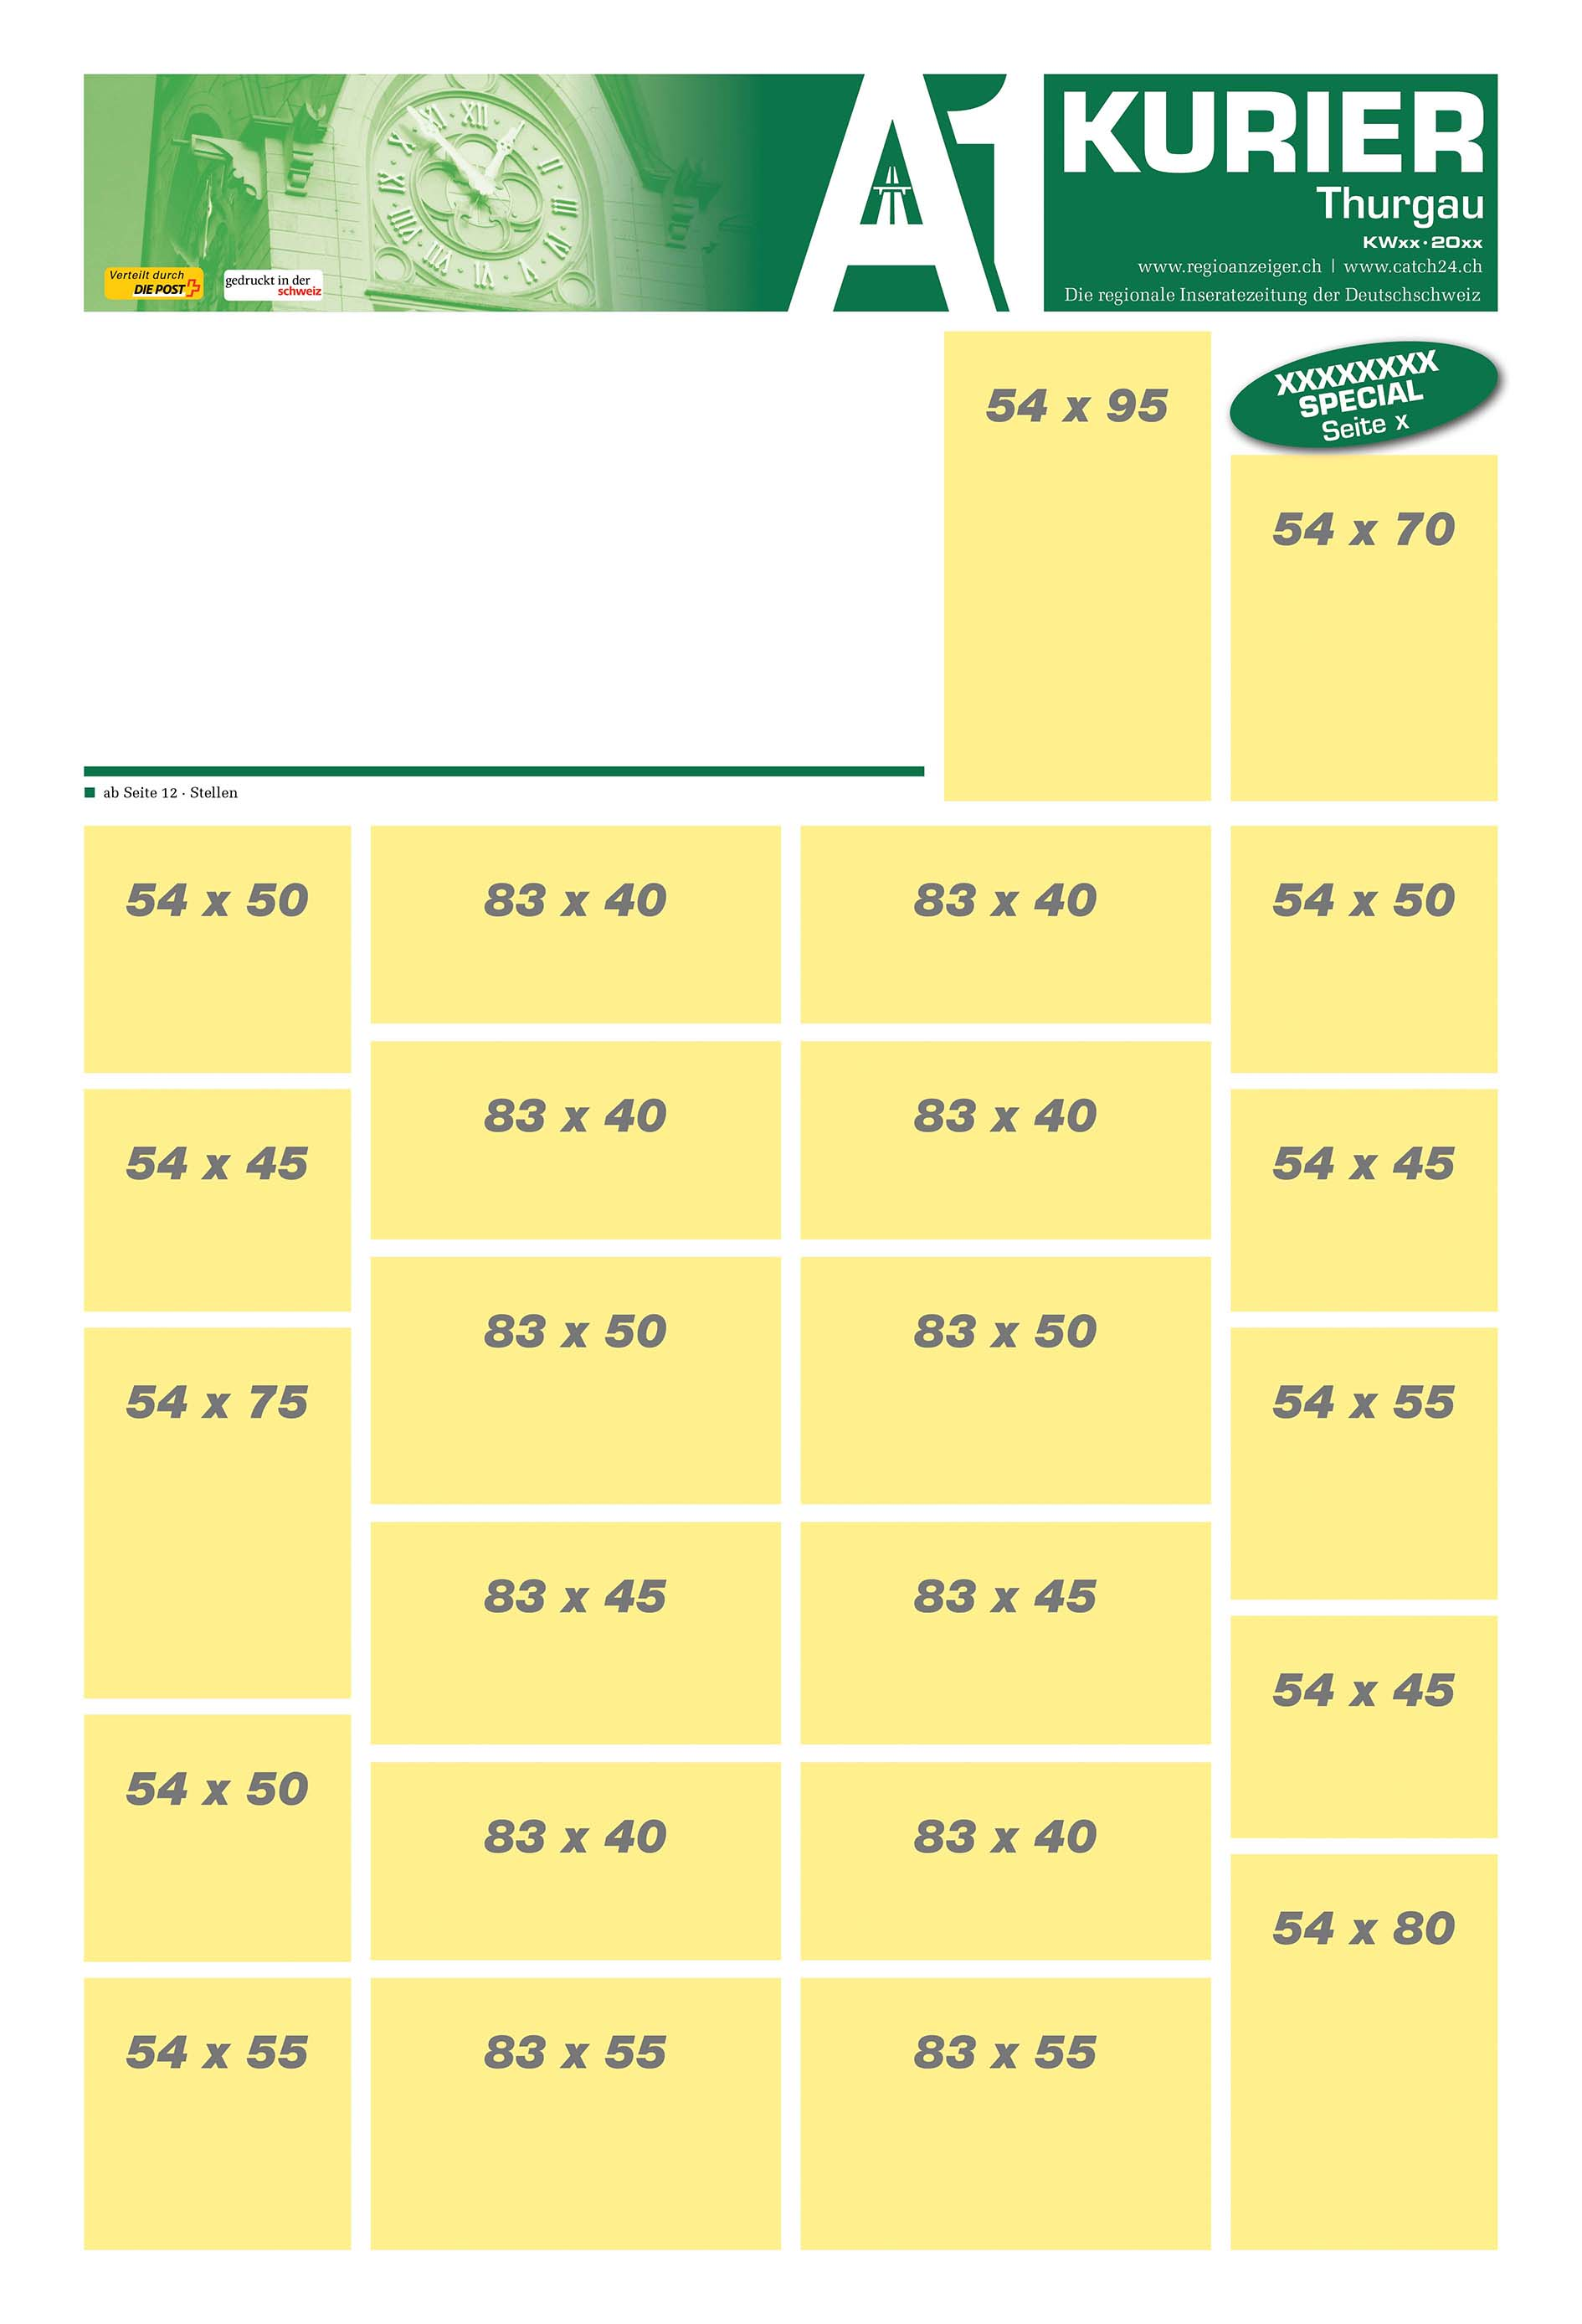
217781
54x50
217643
54x60
217807
54x100
TS/Regio
217941
54x30
217905
141x60

Slide 13
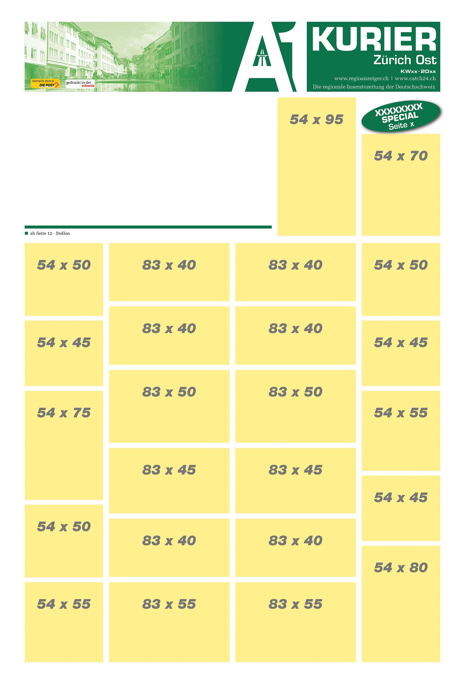
217781
54x50
217643
54x60
217807
54x100
TS/Regio
217941
54x30
217905
141x60

Slide 14
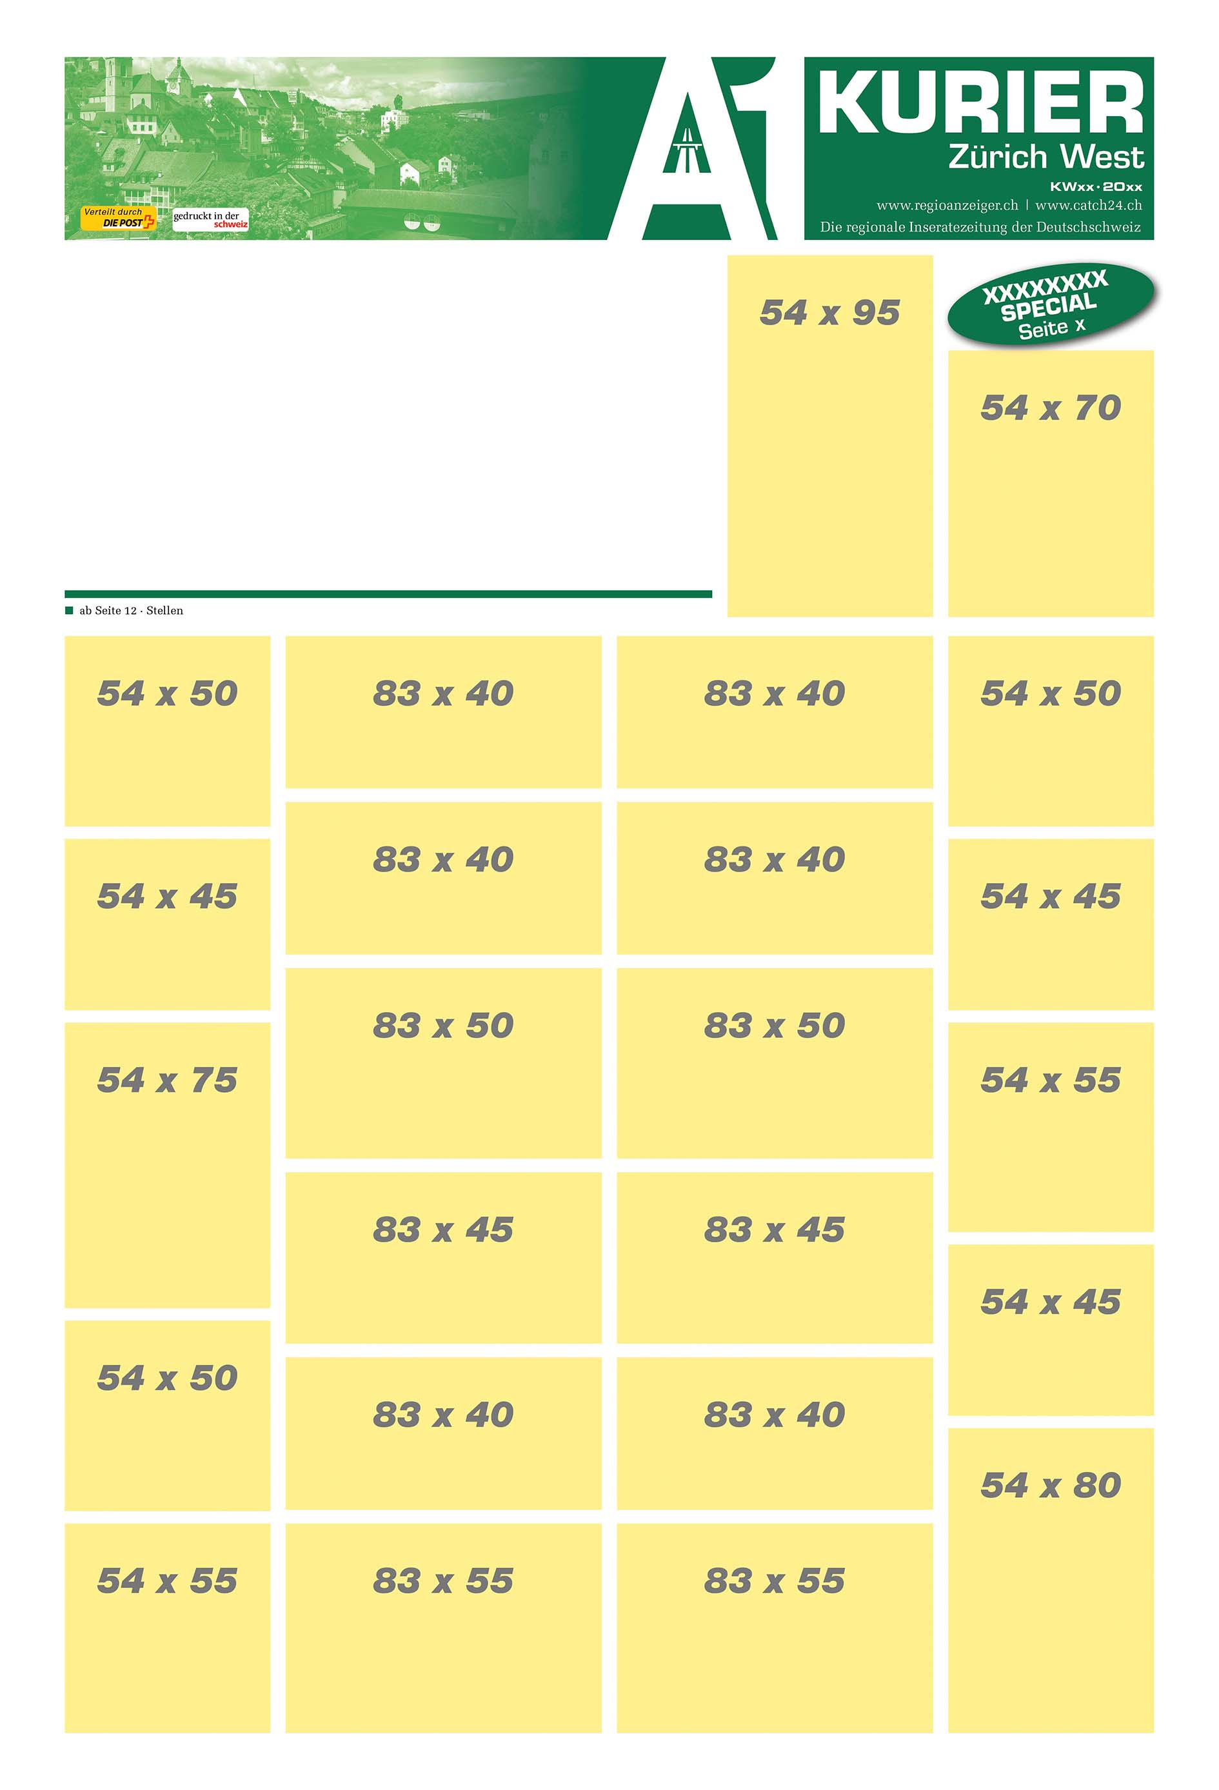
217781
54x50
217643
54x60
217807
54x100
TS/Regio
217941
54x30
217905
141x60

Slide 15
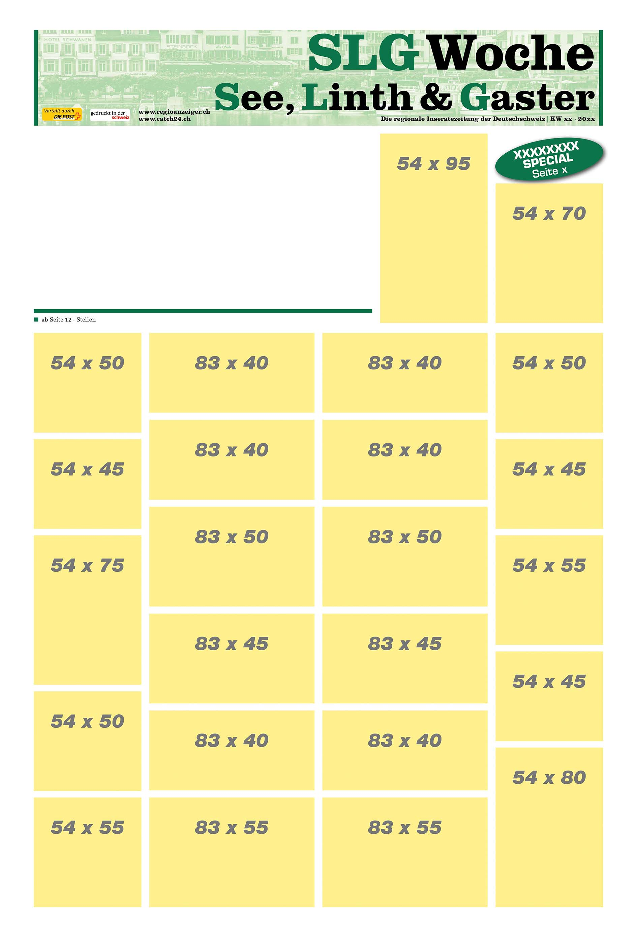
217781
54x50
217643
54x60
217807
54x100
TS/Regio
217941
54x30
217905
141x60

Slide 16
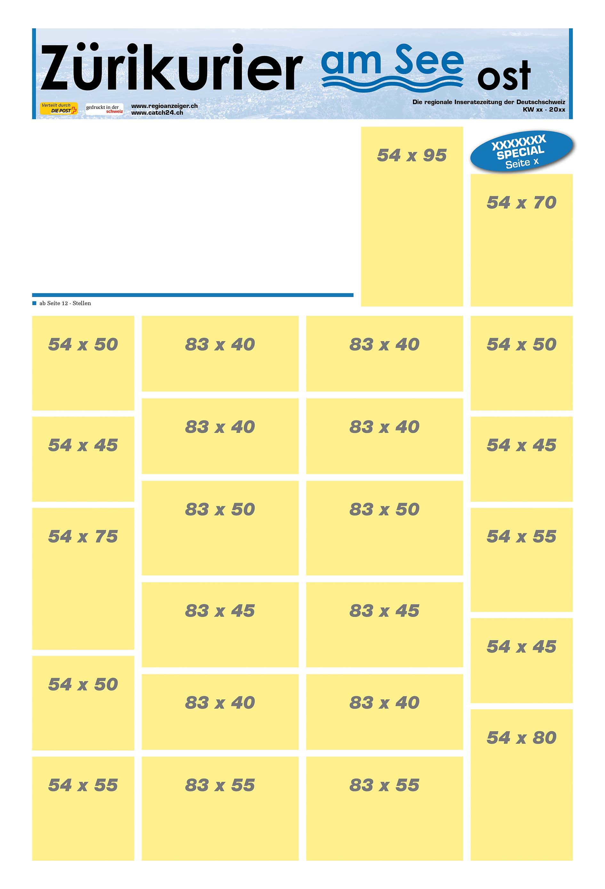
217781
54x50
217643
54x60
217807
54x100
TS/Regio
217941
54x30
217905
141x60

